Slide 2
EFFECTIVE AND EFFICIENT USE
OF THE FUNDAMENTALS OF ENGINEERING EXAM FOR OUTCOMES ASSESSMENT

Slide 3
Overview
Applicability of the FE exam for assessment
ABET student outcomes that can be measured
Computer-based FE exam format
Various methods to use FE exam results for outcomes assessment
Self-study examples and closing the loop
Questions and answers
Notes:
Overview of today’s presentation

Slide 4
Applicability of the FE Exam for Assessment
It is a direct method of objective assessment with comparisons of institutional results against national results.
Assessment does not use pass rates but rather how students perform on individual exam areas.
Because there are over 50,000 FE examinees per year, it provides high reliability.
Notes:
ABET promotes both direct and indirect assessment techniques. The FE exam is one direct assessment technique.

Slide 5
Applicability (cont.)
Should my institution require the FE exam as a graduation requirement?
  Many institutions currently do this to measure their full graduating class.
  This requires a good-faith effort, which is generally determinable only through the amount of time spent on the exam or through the random-guessing analysis done by NCEES.
Notes:
For this assessment process to be valid, the population taking the exam must represent the entire population of graduates from the program. Many institutions that currently use the FE exam as one of their assessment tools require that all seniors take the exam and give a good-faith effort (but not necessarily pass).
Clearly, if the results are to be useful for outcomes assessment, the students must perform in a way that accurately reflects their understanding. It should be noted that when developing the Subject Matter Report (to be discussed later), NCEES works with psychometricians to remove random guessers so that assessment is not influenced by examinees who simply guess rather than attempting to correctly answer the exam questions.

Slide 6
Applicability (cont.)
What if my institution doesn’t require the FE exam as a graduation requirement?
  – A self-selecting group can still be useful for assessment.
  – Anecdotal information indicates that the self-selecting group does not change much at a given institution from exam to exam.
  – Criterion for assessment should focus more on the changes in results over time compared to program-set targets rather than just the comparisons to national data.
Notes:
For this assessment process to be valid, the population taking the exam must represent the entire population of graduates from the program. Many institutions that currently use the FE exam as one of their assessment tools require that all seniors take the exam and give a good-faith effort (but not necessarily pass).
Clearly, if the results are to be useful for outcomes assessment, the students must perform in a way that accurately reflects their understanding. It should be noted that when developing the Subject Matter Report (to be discussed later), NCEES works with psychometricians to remove random guessers so that assessment is not influenced by examinees who simply guess rather than attempting to correctly answer the exam questions.

Slide 7
Applicability (cont.)
Summary
  The FE is the only nationally normed examination addressing specific engineering topics currently available.
  The FE is the only assessment tool available to compare the performance of students in one program with students from other programs.
  The FE can be used as an assessment tool with a pool of all graduates or with a self-selecting pool.
Notes:
Using the FE exam for outcomes assessment is a useful part of a balanced assessment program that includes other standardized tests, assessment tools, alumni surveys, and placement data. The FE exam is the only nationally normed test of lower- and upper-level engineering knowledge. The detailed reports of performance by subject area provide information that can help to evaluate a program’s success in achieving the student outcomes specified by ABET. Over time, these reports can also help programs document the effects of curriculum revisions, teaching innovations, and other actions taken to improve student mastery of engineering topics.
Engineering programs should seriously consider using the FE exam subject-level performance data as part of their program assessment.
A program will gain the most from using the FE exam as an assessment tool if it requires all students to take the exam, particularly the appropriate discipline-specific exam, and if faculty establish specific goals for the program.
Institutions must remember that the primary purpose of the FE exam is to assess minimal technical competence. Other assessment tools need to be used to assess higher-level theories or critical thought that might be the focus of some portion of an institution’s program.

Slide 8
ABET Outcomes Assessment Possible with
FE Exam
(1) An ability to identify, formulate, and solve complex engineering problems by applying principles of engineering, science, and mathematics
FE results can be used to show a program’s ability to provide a foundation of technical knowledge in engineering, science, and mathematics that is necessary for solving complex problems.
Notes:
Approved for the 2019–20 Accreditation Cycle
Bold elements are measurable with the FE.
The new ABET Outcomes went into effect for the 2019–20 visit cycle. It was noted by EAC that they expected that most of the assessment tools currently in effect for (a)-(k) could be easily switched to (1)-(7).
Note: While NCEES recognizes that some questions on the FE Exam do not represent complex engineering problems, the assessment of this outcome could and should include the assessment of basic engineering problems. To satisfy student outcome 1, programs must demonstrate that students can apply the principles of engineering, science and mathematics. The FE exam does a good job of this.

Slide 9
ABET Outcomes Assessment Possible with
FE Exam
(2) An ability to apply engineering design to produce solutions that meet specified needs with consideration of the public health, safety, and welfare, as well as global, cultural, social, environmental, and economic factors
Notes:
Approved for the 2019–20 Accreditation Cycle
Bold elements are measurable with the FE.
Many of the FE exams have specifications that deal directly with engineering design.

Slide 10
ABET Outcomes Assessment Possible with
FE Exam (cont.)
(4) An ability to recognize ethical and professional responsibilities in engineering situations and make informed judgments, which must consider the impact of engineering solutions in global, economic, environmental, and societal contexts
Notes:
The FE exam includes questions on engineering ethics and professional responsibilities.

Slide 11

FE Exam Format
The FE uses a computer-based testing (CBT) format, with testing facilities provided by Pearson VUE testing centers.
The FE exam is available to your students throughout the year.

Slide 12
Test Center Locations
  Nearly 300 Pearson VUE test center locations are available throughout the United States.
  Specific sites near your institution can be located from the NCEES website at the following URL:
    http://ncees.org/exams/test-center-locations/
Notes:
Examinees can locate the test center closest to them when registering. The FE is administered at nearly 300 test centers throughout the United States and Canada. These include more than all Pearson Professional Centers (the NCEES exam is offered at all professional centers). These sites are owned and operated by Pearson VUE. There are also Pearson VUE Select Centers located throughout the country at various academic institutions. Pearson VUE Select Centers have been asked to offer the exams, but it is up to the university if they want to offer the exams.

Slide 13
FE Exam Format
Length
  The appointment time at test centers is 6 hours.
    Tutorial–8 minutes
    Nondisclosure agreement–2 minutes
    Exam time–5 hours, 20 minutes with a 25-minute scheduled break after approximately 55 questions
  Total of 110 questions
Notes:
The exam appointment time is 6 hours total. Once an examinee has completed the check-in process and is seated in front of the computer, he or she will be given 2 minutes to read and respond to a nondisclosure agreement.
Next is a tutorial that will guide them through the various functions of the exam. It shows basic things like how to advance to the next item, return to a previous item, and flag an item for review so you can come back to it later. It also explains how to search the FE Reference Handbook during the exam.
The actual exam will begin once they have completed the nondisclosure agreement and the tutorial. They’ll have 5 hours and 20 minutes to complete all 110 questions. After completing approximately 55 question, or half of the exam, they will be prompted to review and submit this portion of the exam and asked if they would like to take a 25-minute break. After the break, the clock will begin again. At the end of the exam, there is a short survey.

Slide 14
FE Exam Format (cont.)
FE Reference Handbook
  Provided electronically with the exam as a searchable PDF
  Available for free download and for purchase as a hard copy at http://ncees.org/engineering/fe/
NCEES Examinee Guide
Practice exams available for each discipline
Notes:
The FE exam is still a closed-book, with a reference handbook provided onsite. A searchable, electronic copy of the handbook will be displayed on the monitor during the exam. To accommodate for the reference handbook and questions being seen simultaneously, Pearson VUE offer the NCEES exams on a 24” monitor. The FE Reference Handbook is available free download electronically and for purchase as a hard copy.
The NCEES Examinee Guide is the official guide to policies and procedures for all NCEES exams. It has a lot of information that will help walk examinees through the registration and scheduling process. It can also be downloaded free from the NCEES website.
Computer-based practice exams are not available due to the lack of consistent technology owned by students. They would not perform consistently. Paper-based practice exams are available, and they do contain examples of Alternative Item Types. Practice exam booklets contain 100 questions. Sell for $29.95.

Slide 15
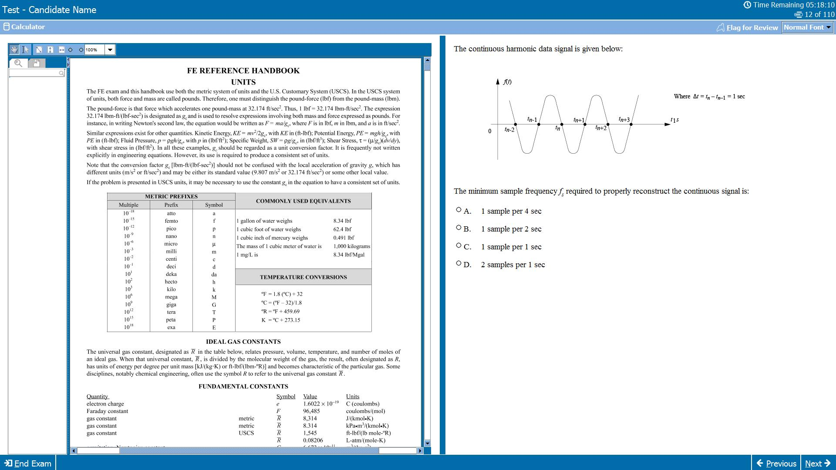
FE Exam Format (cont.)
Example—not for duplication
Notes:
This is screenshot of what the exam will look like to the candidate.
24-inch monitors are used with the searchable supplied reference manual on the left and the exam question on the right.

Slide 16
FE Exam Format (cont.)
Content of the exam
  7 free-standing discipline-specific exams
    Chemical
    Civil
    Electrical and Computer
    Environmental
    Industrial and Systems
    Mechanical
    Other Disciplines
Notes:
The CBT version of the exam consists of 7 free standing discipline-specific exams and each includes 110 questions.

Slide 17
FE Electrical and Computer Exam Specifications—Updated in 2020
Mathematics
Probability and Statistics
Ethics and Professional Practice
Engineering Economics
Properties of Electrical Materials
Circuit Analysis (DC and AC Steady State)
Linear Systems
Signal Processing
Electronics
Power Systems
Electromagnetics
Control Systems
Communications
Computer Networks
Digital Systems
Computer Systems
Software Engineering
Notes:
All exam specifications were updated starting with the July 2020 exams.
This is new FE Electrical and Computer FE exam.
One will note, as will be the case in all of the new exams, that many of the subjects continue from the old specifications to the new ones. This allows the continued use of the FE exam for assessment purposes—as will be shown later—despite the break in exam specifications.

Slide 18
FE Civil Exam Specification–Example of Engineering Design
11. Structural Engineering
    Design of steel components (e.g., codes and design philosophies, beams, columns, tension members, connections)
    Design of reinforced concrete components (e.g., codes and design philosophies, beams, columns)

Slide 19
Other Exam Specifications
Available at http://ncees.org/engineering/fe/
Notes:
Specifications of all of the 7 discipline-specific FE exams are available at this URL.

Slide 20
So, what actual data are available, and what can you do with the data?

Slide 21
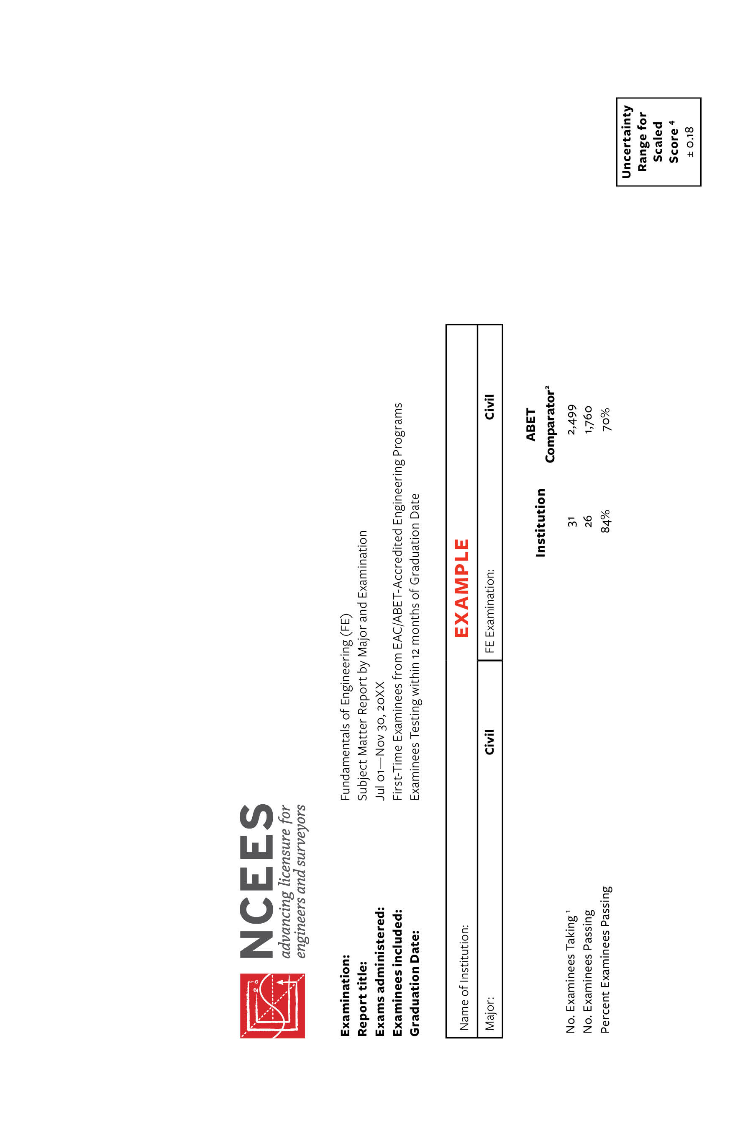
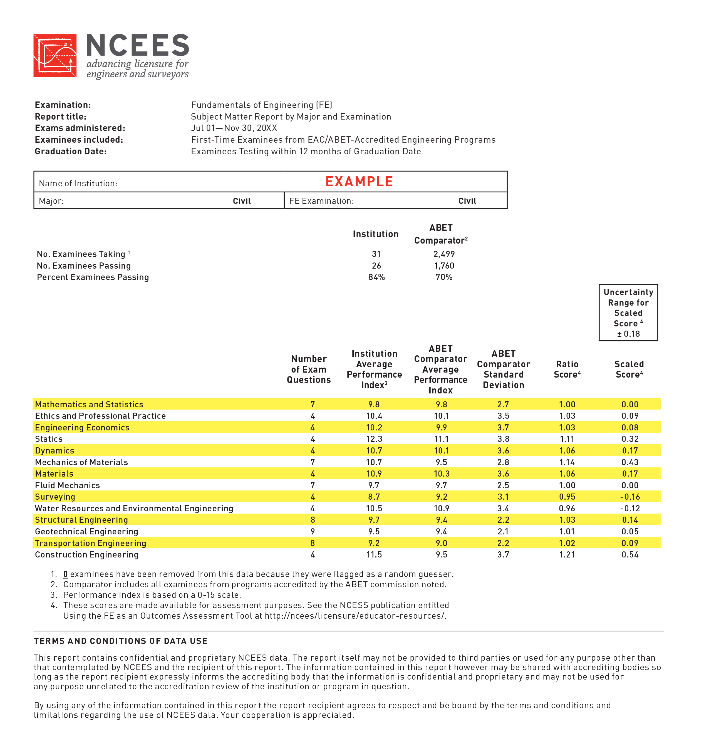
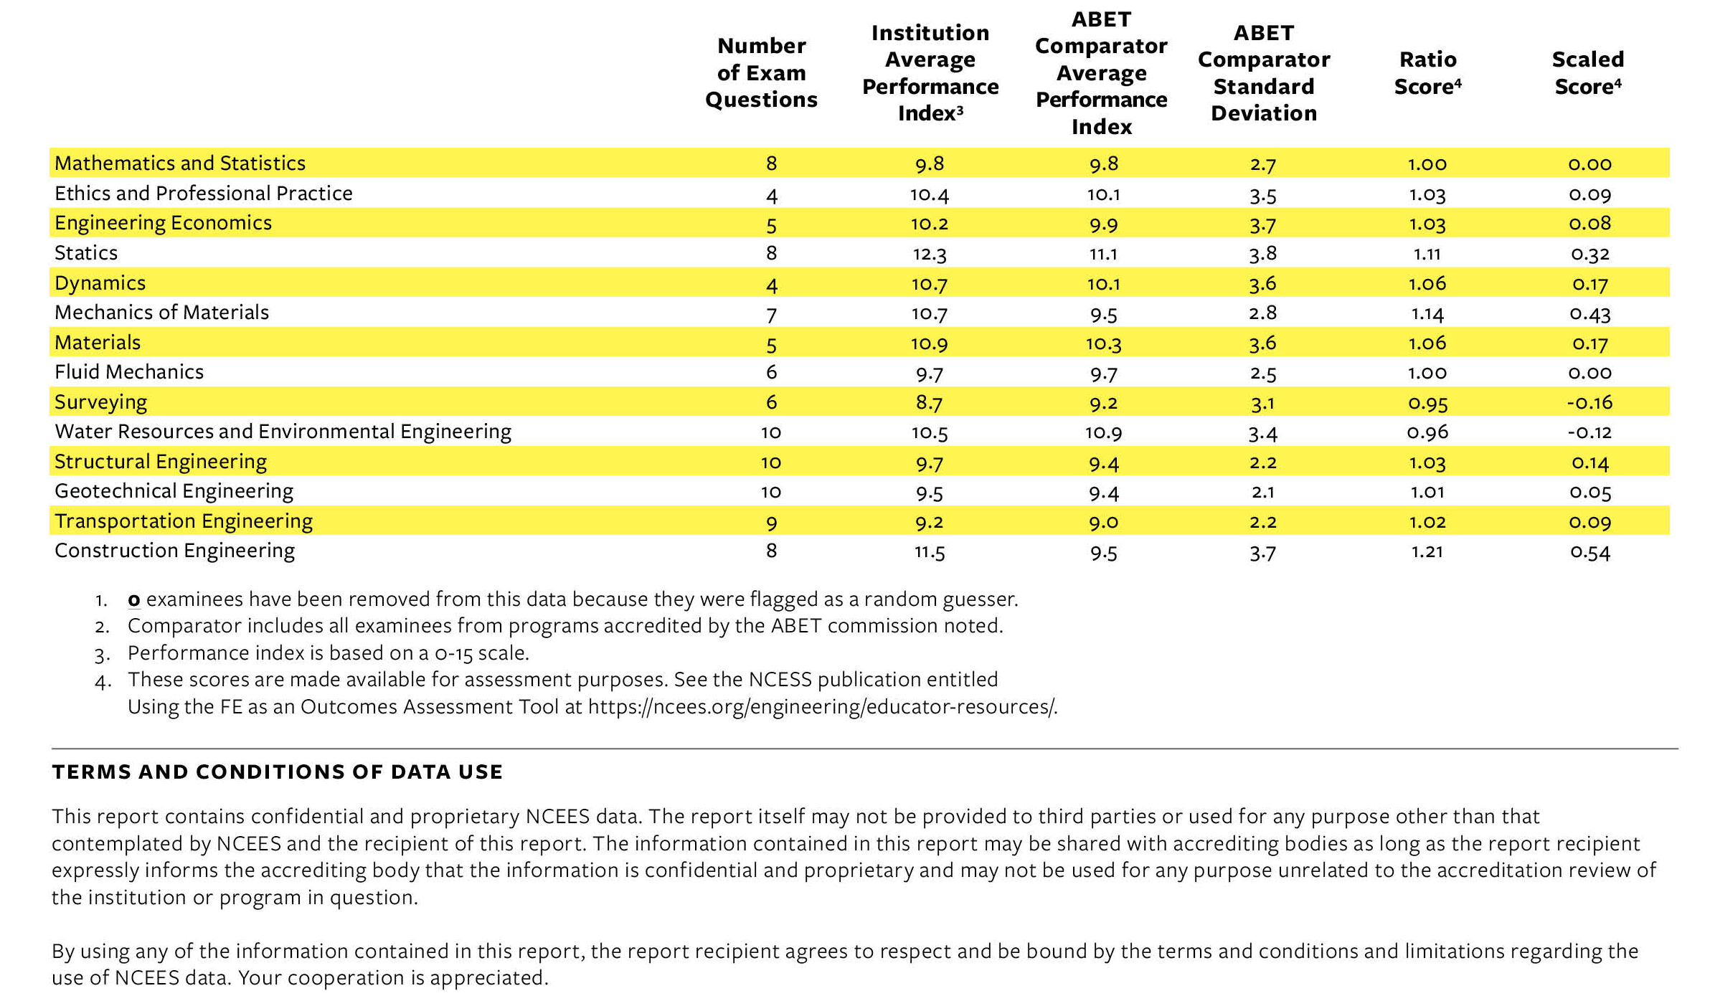
Subject Matter Report
Notes:
This is what the new Subject Matter Report looks like.
It contains information for both the institution/program and the national performance. Pass rates are given—however, we emphasize that, for assessment purposes, one should not use the pass rate.
Don’t spend a lot of time on this slide as the details of what is contained in the Subject Matter Report is covered on the next few slides.

Slide 22
Subject Matter Report (cont.)
Reports are generated twice a year.
  In July for the January–June testing period (spring)
  In January for the July–December testing period (fall)
The report is specific to the following:
  An institution
  Students within an engineering degree program at that institution
  The discipline-specific exam that those students completed
Notes:
Provides information on when the reports will be generated and the fact that they are very specific to a set of students at the institution.

Slide 23
Subject Matter Report (cont.)
Data are provided for all examinees testing within 12 months of graduation (either before or after graduating).
Only first-time takers are included.
Random guessers are removed from the report.
National performance data, with standard deviation information, are also provided for the same degree program and same discipline-specific exam.
Notes:
The report will contain information for examinees who are within 12 months of graduation.
For institutions that require the FE exam as a graduation requirement, administrators may need to institute some sort of approval process that restricts a student from taking the exam more than 12 months prior to his or her expected graduation date.
The 12-month period will allow institutions to capture data on recent graduates who take the exam no later than 9 months after graduation.
Only first-time takers are included.
As in the past, random guessers are removed from the report. NCEES has a technique by which it identifies random guessers.
The presence of the national data is what allows the FE exam to be an excellent direct assessment method since we can compare the program’s performance versus the national performance.

Slide 24
Subject Matter Report (cont.)
For each topic, the students’ performance is given as a Performance Index on a scale of 0 to15.
The Performance Index is indirectly related to the average number of questions answered correctly.
This is necessary because each examinee receives a different set of questions within each topic area.
Notes:
Need to briefly describe the Performance Index.
Since each examinee gets a different set of questions within each topic area, simply calculating the percentage of questions correct will not allow for accurate comparisons. For example, consider a topic area with 10 questions. Candidate A gets 10 questions that, overall, are easier than the 10 questions that Candidate B gets. If they both answer 8 questions correct, the Performance Index for A might be 11.2 while the Performance Index for B might be 11.8.
It should be made clear that every examinee’s complete exam has the same “hardness” (the psychometricians must have a better name for this) as everyone else’s exam.

Slide 25
Subject Matter Report (cont.)
Getting the data
  – NCEES sends links to reports directly to an institution via email.
  – If you don’t know, NCEES can tell you who receives your institution’s reports.
  – Reports also include information on the specific institution’s examinee who took the FE or PE exam more than 12 months after graduation.
Notes:
Contact NCEES if you don’t know who is receiving the links to the reports at your institution.

Slide 26
Specifics of Using the
FE Exam for Outcomes Assessment

Slide 27
Getting Started
Involve faculty.
Identify areas of strength.
Acknowledge areas that are not emphasized.
Set program-specific goals for each area.
Notes:
To properly use the FE exam as an assessment tool, the department or program faculty should first determine what topics they already emphasize in their program. This is a major part of the program educational objectives and student outcomes set by each program as required by ABET. Prior to beginning using the exam for assessment purposes, faculty should determine the expected performance in each topic area, depending on the emphasis of that topic in their program. For example, if a civil engineering program places little emphasis on surveying or transportation, students should be expected to perform accordingly. Conversely, if the program has a strong emphasis on structural analysis, one would expect a much higher performance in this area compared to the national average. After establishing the topics to be emphasized, faculty should set specific goals for student performance and then use the relevant portions of the FE exam to assess the students’ knowledge in specific areas, such as water resources, electric circuits, or machine design. The faculty should then compare their goals to the knowledge demonstrated by graduates of the program.

Slide 28
Table from Self-Study Showing the Use of the FE as One Measure for a Specific Outcome
Outcome | Applicable FE Exam Category
1. An ability to identify, formulate, and solve complex engineering problems by applying principles of engineering, science, and mathematics | Mathematics and Statistics, Geotechnical Engineering, Transportation Engineering, Water Resources and Environmental Engineering
2. An ability to apply engineering design to produce solutions that meet specified needs with consideration of public health, safety, and welfare, as well as global, cultural, social, environmental, and societal contexts | Structural Engineering, Engineering Economics
3. An ability to communicate effectively with a range of audiences | None
4. An ability to recognize ethical and professional responsibilities in engineering situations and make informed judgments, which must consider the impact of engineering solutions in global, economic, environmental, and societal concerns | Ethics and Professional Practice
5. An ability to function effectively on a team whose members together provide leadership, create a collaborative and inclusive environment, establish goals, plan tasks, and meet objectives | None
6. An ability to develop and conduct appropriate experimentation, analyze and interpret data, and use engineering judgment to draw conclusions | None
7. An ability to acquire and apply new knowledge as needed, using appropriate learning strategies | None
Notes:
This department used FE results as one of the assessment tools fort outcomes 1, 2, and 4
Note that several sections of the FE are used for a single outcome, thus providing redundant measurements.

Slide 29
Suggested Analysis Techniques
Choose your longitudinal time basis.
  – Performance from multiple examination windows
  – Academic year performance
Choose your presentation method.
  – Ratio method
  – Scaled score method
Notes:
For assessment, faculty should consider longitudinal performance over time rather than results from one Subject Matter Report. The longitudinal time periods can either be each Subject Matter Report (every 6 months) or academic year performance can be computed by averaging the December report in year XXXX with the June report in year XXXX+1.
The form of this expected performance will depend on the analysis method chosen, a variety of which have been developed to examine the data from the Subject Matter Report with regard to program assessment. The two methods described in the white paper are the ratio method and scaled score method.

Slide 30
Ratio Method
The ratio score is simply the ratio between the program’s performance index (P.I.) in any topic area and the P.I. of the comparator performance.
  Ratio score = Program P.I./Comparator P.I.
Notes:
The first method presented is the Ratio Score Method.
It is simply the ratio of the performance indexes.

Slide 31
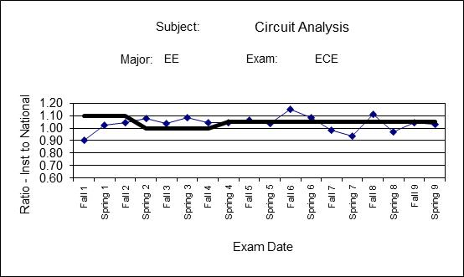
Comparison of Ratios by Subject Area
Expectation
Notes:
You can see how the break in specifications in handled in the plot.
Issues to be pointed out here:
3 exams are below the goal (red circle).
Faculty looked at the situation and decided that they had set an unrealistic goal of being 10% better in basic circuit analysis that EEs from other institutions (orange circles).
The goal was reexamined a couple of years later and it was decided to still ask for more than the national average (goal now 5% above).
Most of the exam results are above the goal (green circles).
No other time has there been 3 consecutive exams below the goal.
The presenters would suggest the following procedure when a ratio score is below the expectation:
1st time—just note that it occurred.
2nd consecutive time—put on a serious watch list.
3rd consecutive time—need to instigate remedial action.

Slide 32
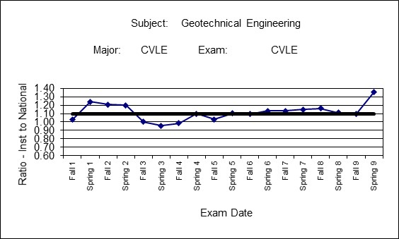
Comparison of Ratios by Subject Area
Expectation
Notes:
Key is the 3 exams below the goal. This institution determined that there had been an instructor change just prior to the students taking the exam in fall 3, spring 3, and fall 4. Original instructor (well known in the area of soil mechanics and foundations) was put back in the course and response was positive other than fall 5.
Some remedial training was given to the students who had the “poor” instructor.

Slide 33
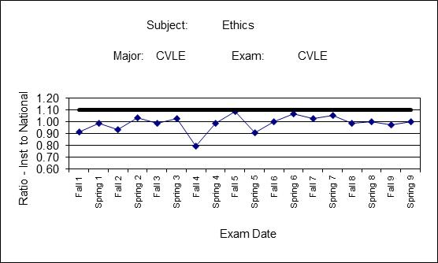
Comparison of Ratios by Subject Area
Expectation
Notes:
Key here is the unrealistic goal. Probably should be 1.0.

Slide 34
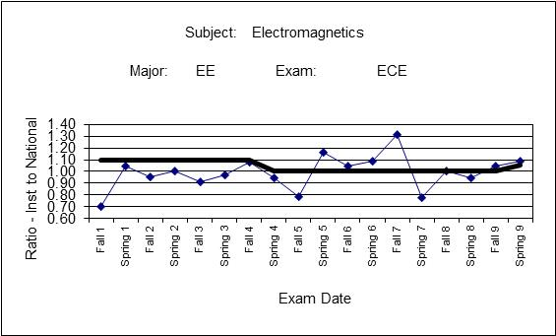
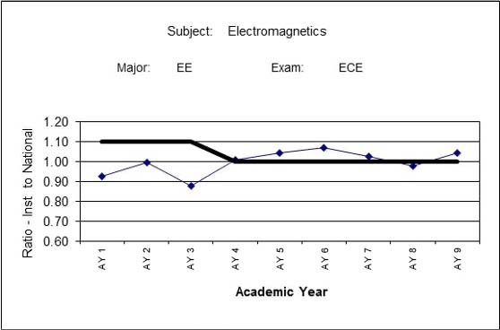
Effect of
Academic
Year
Averaging
Causes a smoothing of the data—Note the fall/spring 5 and fall/spring 7 results compared to the academic year 5 and academic
year 7 results.
Notes:
Academic year averaging causes a smoothing of the data and a better measure of your entire graduating class. Fall 5 is below the goal and spring 5 is above the goal. Academic year 5 is above the goal. Similarly, fall 7 is above the goal and spring 7 is below the goal. Combined, academic year 7 is above the goal.

Slide 35
Scaled Score Method
PI for Univ X – PI comparator
S.S. =
PI comparator standard deviation
1
±
√
# of takers at Univ X
Notes:
Definition of Scaled Score
It’s basically the number of standard deviations above or below the national average.
A S.S. of zero indicates that the institution is at the national average. A positive S.S. indicates that the institution is above the national average.
The 1/$\sqrt{n}$ terms allow for an uncertainty range for programs with a small number of examinees.

Slide 36
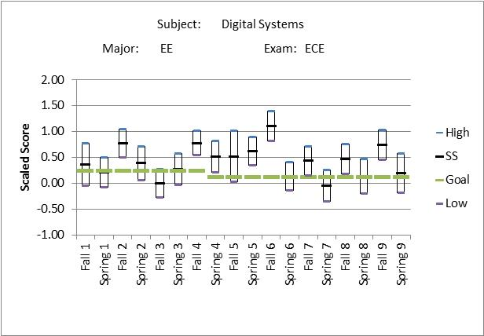
Comparison Using Scaled Score by Subject Area
Expectation
Notes:
No action needed because even when the actual scaled score is below the expectation level, the uncertainty bars pull it into the green category.

Slide 37
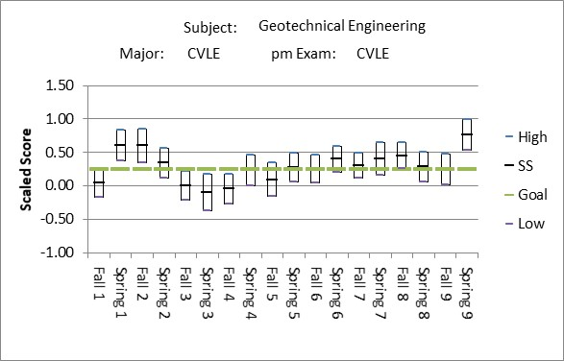
Comparison Using Scaled
Score by Subject Area
Expectation
Notes:
Same 3 exams as we saw before in the ratio section. Even within the uncertainly bar, the institution should—and did—take action.

Slide 38
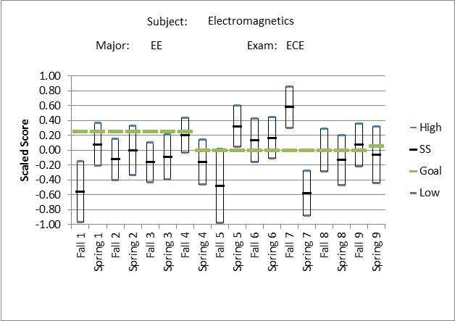
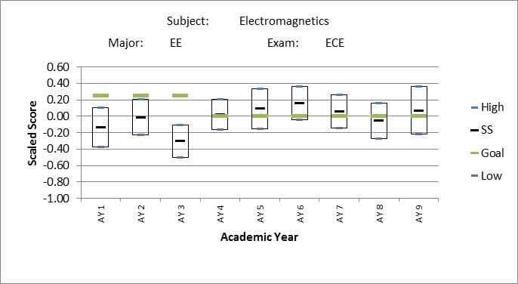
Academic
Year
Averaging
Notes:
Same effect as in the ratio score approach

Slide 39
Examples of Assessing Some of the ABET (1)–(7) Outcomes

Slide 40
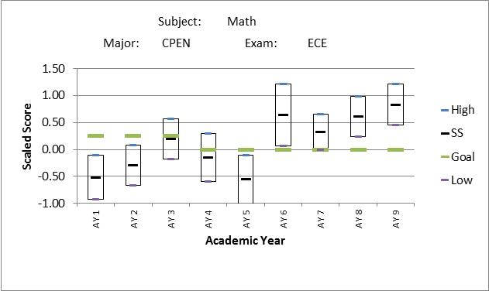
Outcome 1: Ability to Apply Math and Science
Notes:
While (1)–(7) don’t specifically require the assessment of math and science, it does imply that students should know how to apply the principles of math and science.

Slide 41
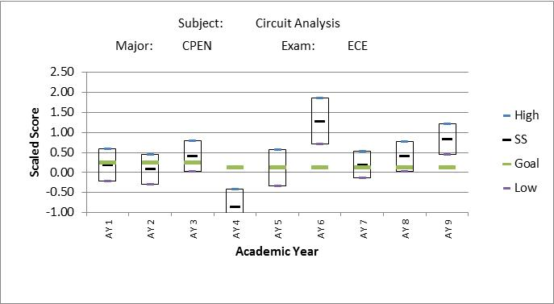
Outcome 1: Ability to Solve Engineering Problems
Notes:
Circuit analysis might be chosen by the institution as one of several FE subjects that would measure the ability of the students to solve engineering problems.
While it is recognized that the FE exam does not test on complex engineering problems, a series of engineering-related topic areas can be used to measure some portion of outcome (1)
Positive assessment for this topic

Slide 42
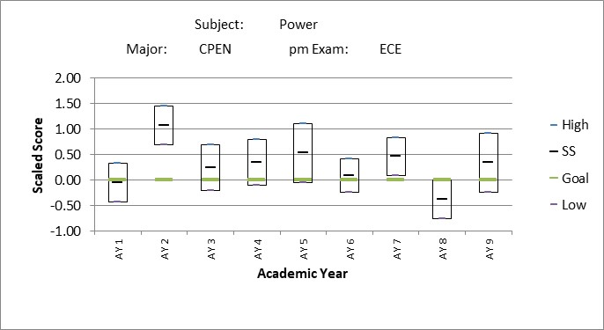
Outcome 1: Ability to Solve Engineering Problems
(AY)
Notes:
This shows the subject Power for Computer Engineers. Probably low-level importance for computer engineers, but it demonstrates larger uncertainty bars due to low number of CPEN students and that AY8 falls in the green area within the degree of uncertainty.

Slide 43
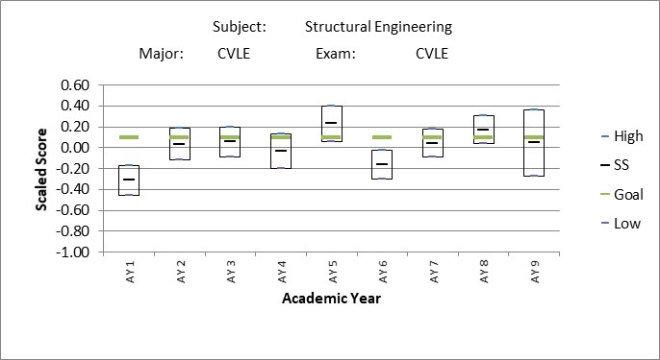
Outcome 2: Ability to Apply Engineering Design
Notes:
This institution believes that it excels in structural design (thus the goal of 0.15). Somewhat mixed analysis.

Slide 44
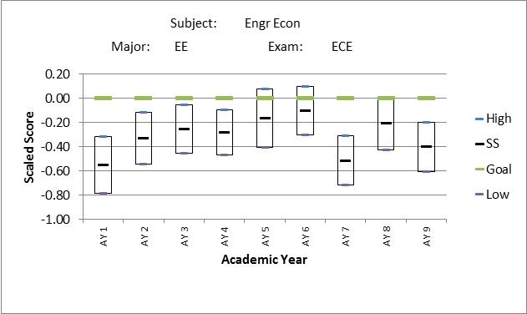
Outcome 2: Ability to Apply Economic Factors in Design
Notes:
Engineering Economics is mentioned in outcome (2).
In any case, this institution was doing poorly in engineering economics. Not surprising since electrical engineers generally do not take a formal course in this area. Lectures on engineering economics were introduced into the senior design sequence and the performance generally increased to acceptable limits. Mixed results recently, however.

Slide 45
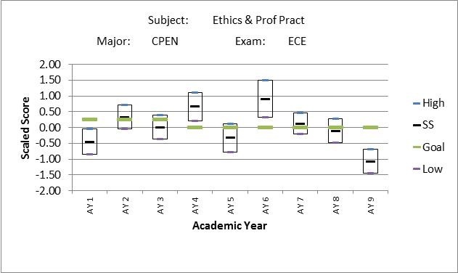
Outcome 4: Ability to Recognize Ethical Responsibility
Notes:
FE subject of Ethics and Professional Practice can be used to assess outcome (4).
Generally positive assessment within the uncertainty due to small sample size although this subject would be on the watch list after AY 9. If no improvement in AY 10, then corrective action would need to be taken.

Slide 46
Conclusions
Discipline-specific assessment information can be gleaned from this exam.
FE exam provides a direct, quantitative assessment technique.
The Subject Matter Report provides comparative data.
NCEES sends a link to the Subject Matter Report directly to your institution via email.
Thus, the FE exam is one effective assessment tool to be used as part of your institution’s full assessment package.

Slide 47
Additional Resources
For more information on reports, email fereports@ncees.org.
NCEES publishes a white paper and several accompanying documents that describe in detail how engineering departments can use the FE exam to assess program outcomes.
Available for free download at
  http://ncees.org/engineering/educator-resources/

Slide 48
Additional Resources
For further information, contact
Cheryl Warren, Ph.D., P.E.
NCEES Exam Development Engineer
800-250-3196, ext. 5472
email: cwarren@ncees.org

Slide 49
Questions?

